Slide 1
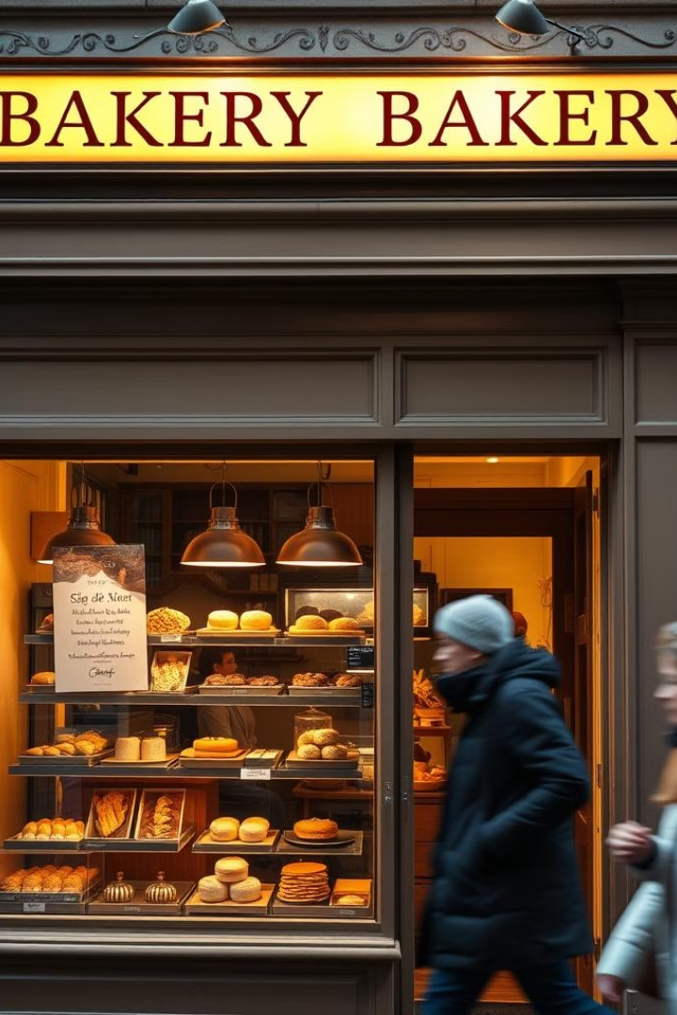

Online Bakery System
The Online Bakery System is a user-friendly e-commerce website that allows customers to easily browse, purchase, and connect with a local bakery business. With a modern and responsive design, the system provides a seamless shopping experience for a variety of freshly baked goods.
by Sanjay Sivaprakash

Slide 2
Website Overview
Intuitive Navigation
Detailed Product Info
Seamless Checkout
The website features a clean and organized layout, making it easy for customers to find what they're looking for.
Each bakery item is showcased with high-quality imagery, descriptions, and pricing to help customers make informed decisions.
The streamlined checkout process allows customers to securely complete their purchases with various payment options.

Slide 3

Key Features
1
Product Catalog
2
Shopping Cart
Browse an extensive selection of freshly baked goods, including breads, pastries, cakes, and more.
Easily add items to the cart and manage orders before checkout.
3
Customer Support
4
Responsive Design
Reach out to the bakery team through the contact form for any inquiries or feedback.
The website adapts seamlessly to various devices, ensuring a great user experience on any platform.

Slide 4
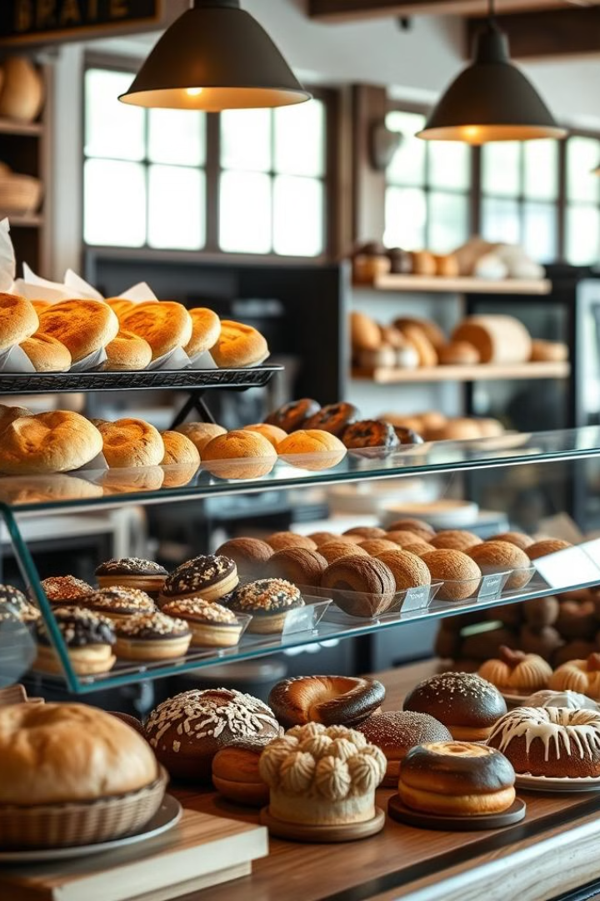
Product Catalog
Breads
Pastries
A wide selection of freshly baked artisanal breads, including sourdough, whole wheat, and specialty loaves.
Indulge in a variety of flaky, buttery pastries such as croissants, danishes, and hand-crafted tarts.
Cakes & Desserts
Seasonal Specials
Satisfy your sweet tooth with an array of decadent cakes, pies, and other tempting desserts.
Explore a rotating selection of limited-time offerings and seasonal favorites.

Slide 5





Shopping Cart Integration
Add to Cart
Adjust Quantities
Easily add any item from the catalog to the shopping cart.
Update the quantity of items in the cart before checkout.
Remove Items
Secure Checkout
Delete unwanted items from the cart with a single click.
Proceed to the checkout page to complete the purchase.

Slide 6




Checkout and Payment Gateways
Review Order
Customers can review their cart contents and make any final adjustments.
Enter Details
Customers provide their shipping and payment information to complete the transaction.
Secure Payment
The website integrates with trusted payment gateways to ensure a safe and reliable checkout process.

Slide 7

Contact Form and Customer Support
1
Inquiries
Customers can use the contact form to ask questions, provide feedback, or request additional information.
2
Response
The bakery team will promptly respond to customer inquiries and provide personalized assistance.
3
Ongoing Support
Customers can continue to reach out to the bakery for any post-purchase support or concerns.

Slide 8
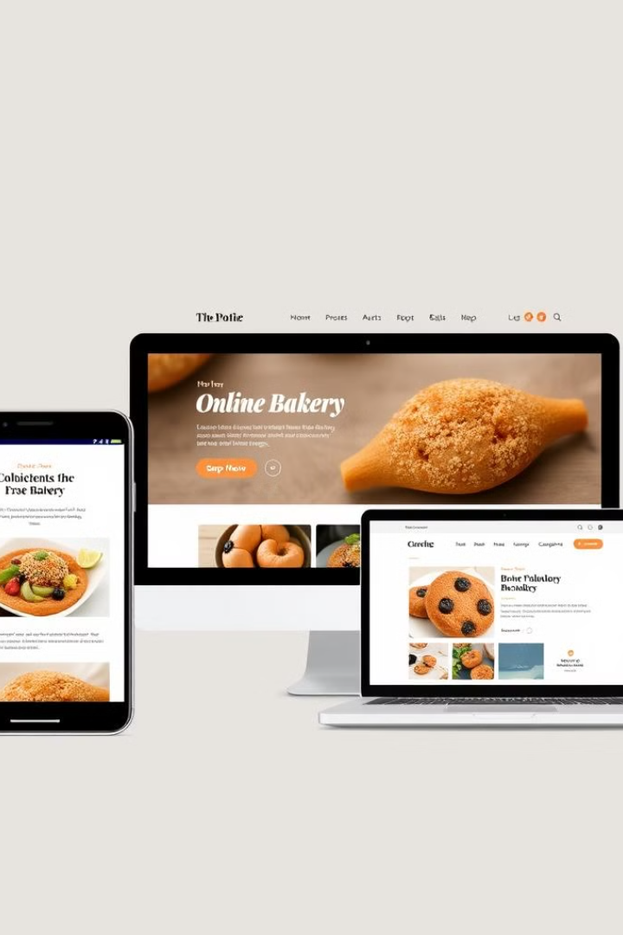
Responsive Design and Usability
Mobile Optimized
The website adapts seamlessly to small screens, providing an exceptional user experience on smartphones and tablets.
Easy Navigation
Intuitive menu structures and clear call-to-actions make it simple for customers to find and purchase their desired items.
Accessible Design
The website adheres to accessibility standards, ensuring an inclusive experience for all users.

